Slide 1
WLAN Analysis
F3

Slide 2
Network protocols used
At first only ARP was used to listen to the network, but then the question arose: what similar network package types could be used to achieve more accurate data. Research showed that these protocols would be helpful. Note that the program just listens to the WLAN, it does not send anything into the network like pings.
ARP (Address Resolution Protocol): ARP is used to convert an IP address to a physical (MAC) address. It's used when a device wants to communicate with another device on the same network and needs to find out the MAC address of the target device.
ICMP (Internet Control Message Protocol): ICMP is used by network devices to send error messages and operational information. For example, the famous "ping" command uses ICMP to test the reachability of a host on an IP network.
UDP (User Datagram Protocol) port 67: This port is used by the DHCP (Dynamic Host Configuration Protocol) server. DHCP is used to dynamically assign IP addresses to devices on a network.
UDP port 53: This port is used by the DNS (Domain Name System) protocol. DNS is used to translate domain names (like www.google.com) into IP addresses that computers can understand.
UDP port 1900: This port is used by the SSDP (Simple Service Discovery Protocol). SSDP is a protocol of the UPnP (Universal Plug and Play) set of protocols, and it's used for discovery of network devices and services.
UDP port 5353: This port is used by the mDNS (Multicast Domain Name System) protocol. mDNS is used in small networks where a conventional DNS server is not available to resolve host names in the local network.
Ether proto 0x88cc: This is the Ethernet protocol type for LLDP (Link Layer Discovery Protocol). LLDP is used by network devices to advertise their identity and capabilities on a local network.
Ether proto 0x2000: This Ethernet protocol type is used by the Cisco Discovery Protocol (CDP), a proprietary protocol designed by Cisco to help administrators collect information about both locally attached and remote devices.
Ether proto 0x6003: This Ethernet protocol type is used by DEC (Digital Equipment Corporation) MOP (Maintenance Operations Protocol). MOP might be used for tasks like remote loading of software or remote system booting.
Further analysis of these protocols is on the next slide →

Slide 3
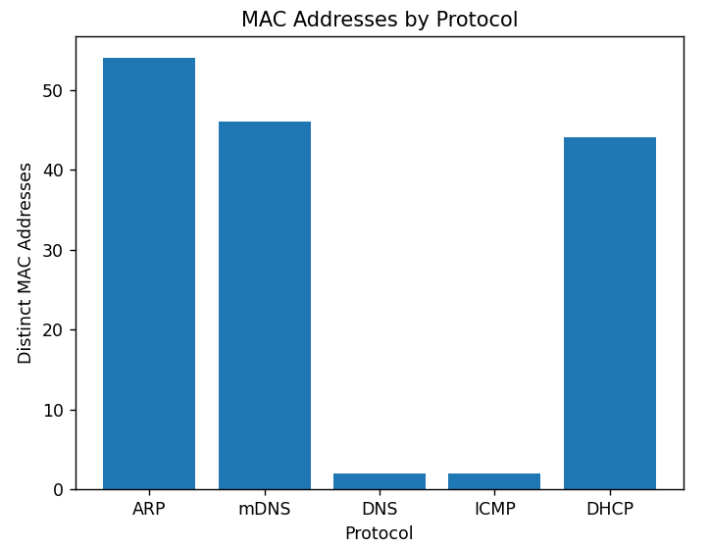
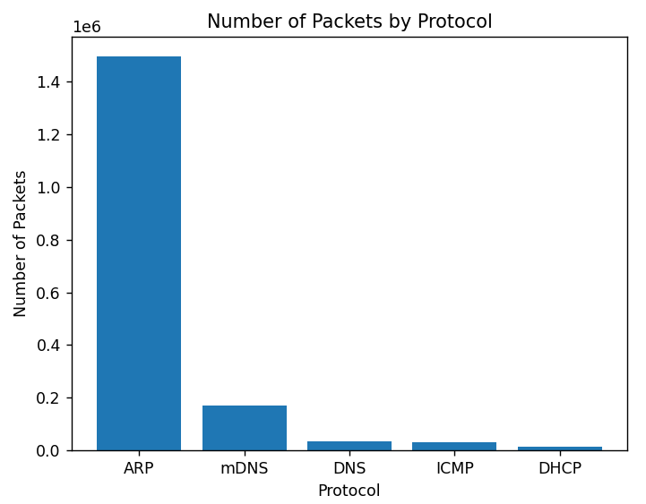
Network protocols statistic of one day
The protocols SSDP, LLDP, CDP and DEC did not show up on that Friday at all.

Slide 4
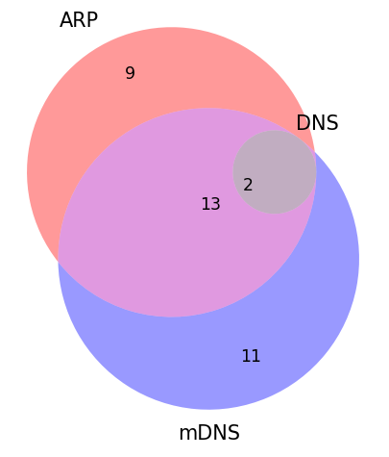
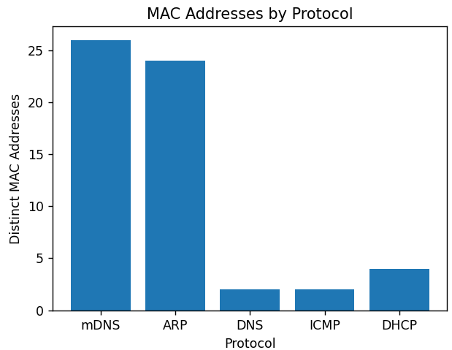
Network protocols
Data: Distinct MAC addresses recorded from Friday 10:00 –10:30. The diagram shows that ARP and mDNS packages together contain all mac addresses in this study. , so using ARP alone would not be beneficial.
However, it is still best if the other network package types get analyzed, because all devices are different and there may be some device that only sends ICMP or LLDP.
Data: Amount of all packages of one Friday, categorized by protocol.
ARP is responsible for the majority of packages. The other protocol do not appear very often. For that reason, it has no downside to include these protocols in the analysis.

Slide 5
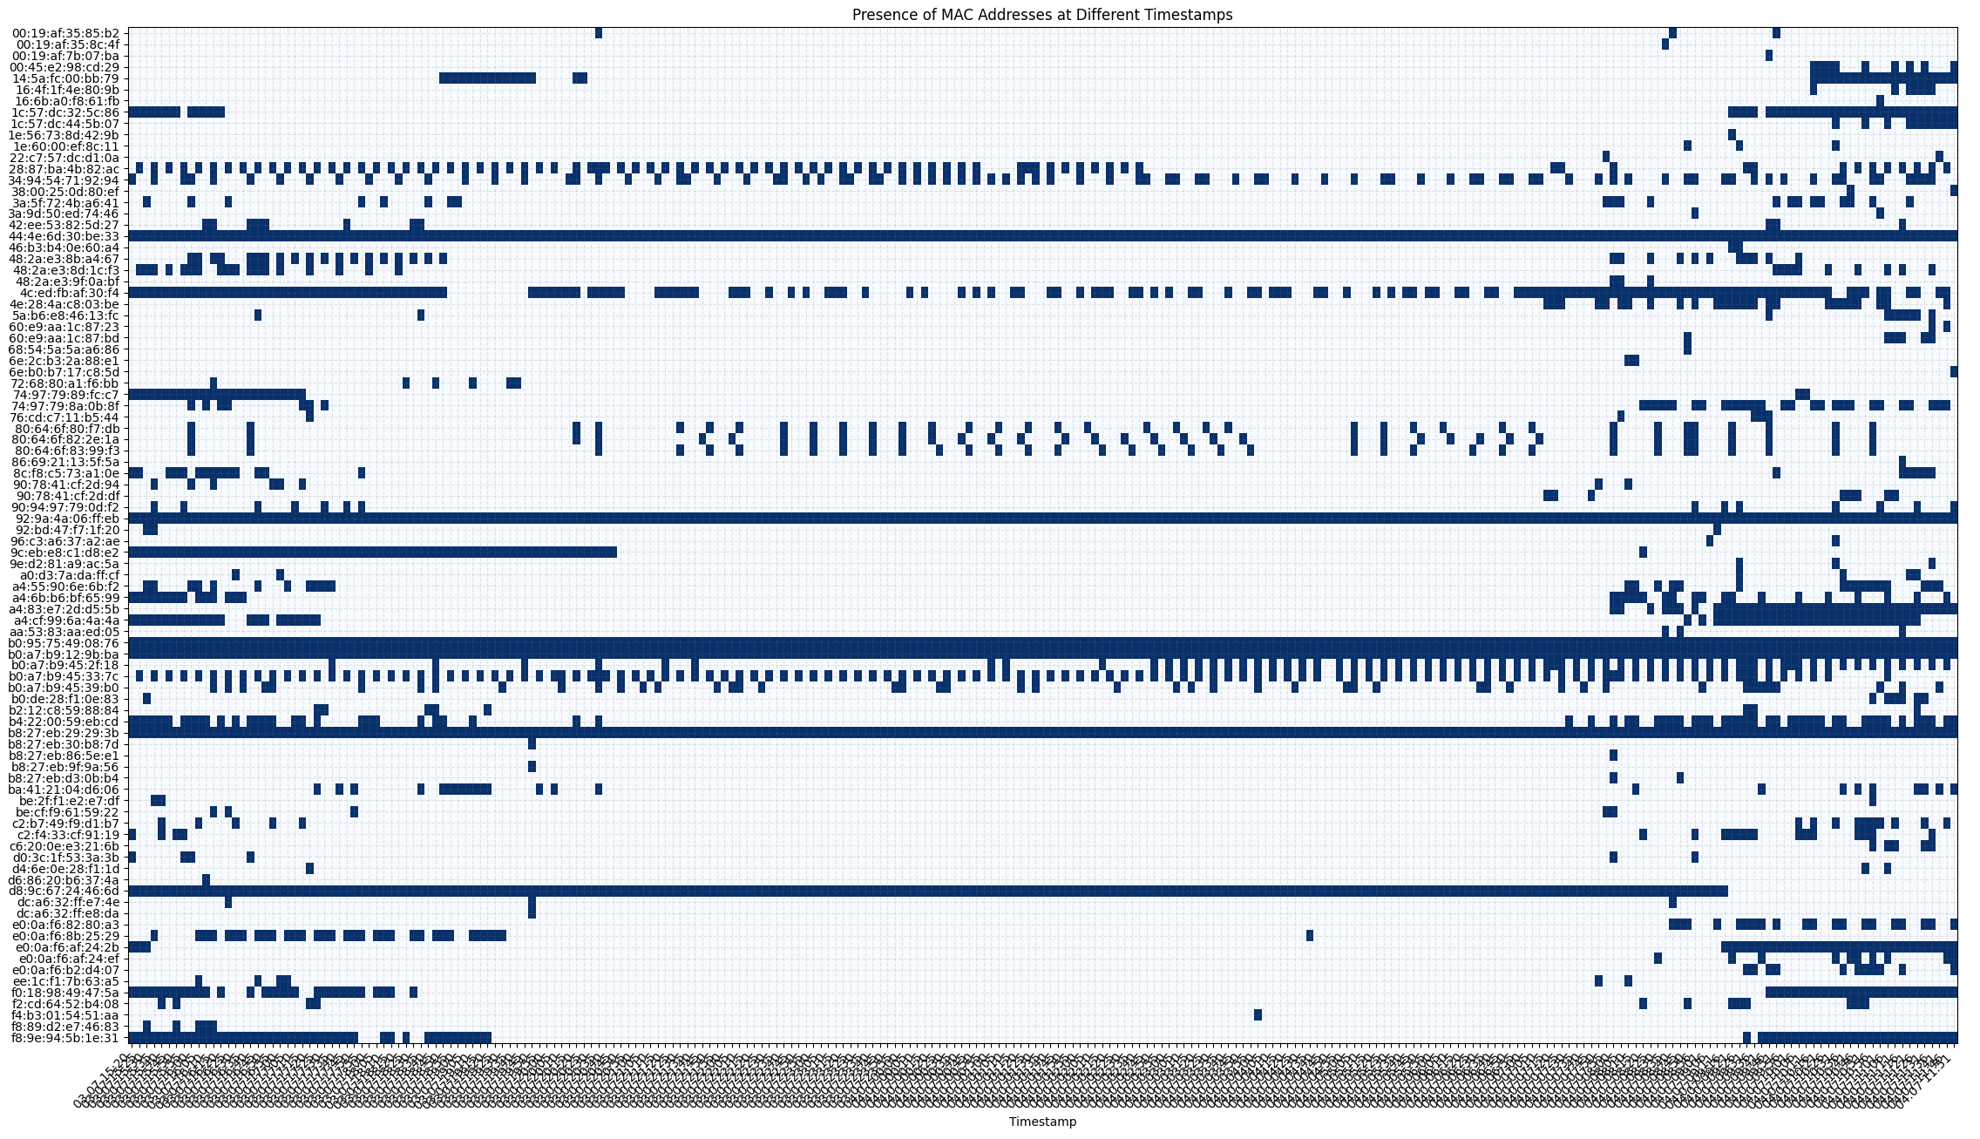
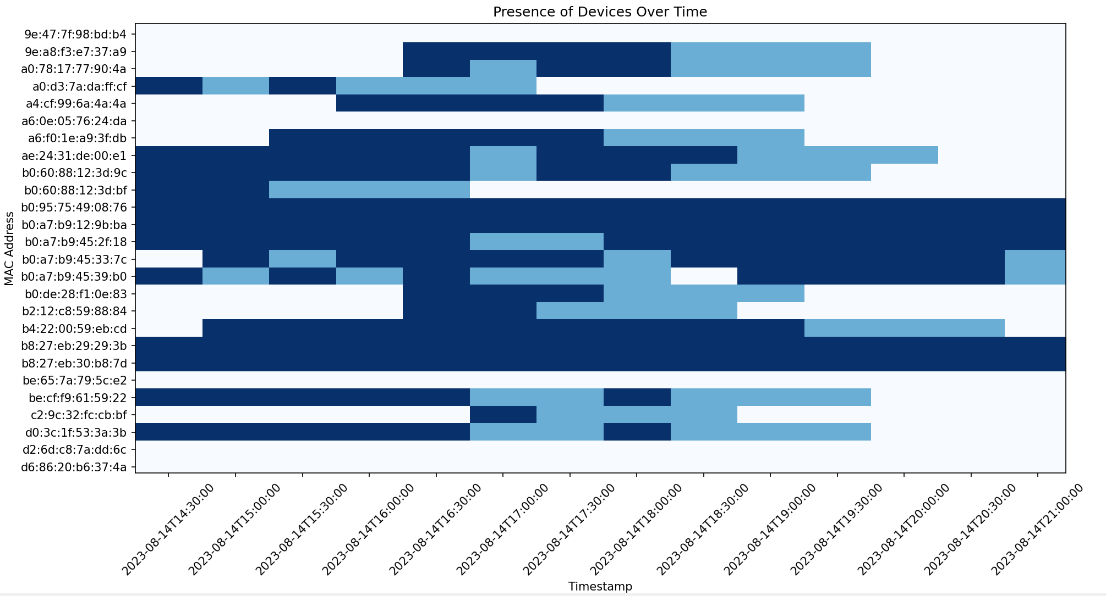
Gap Filling
1
ARP and other network protocols send packets all the time, but irregularly. The intervals for network packages depend on the device type and manufacturer. This can be seen in the diagram very well.
The data in this diagram is in 5-minute-steps. At [1] the device sends network packages in 10-minute-intervals, but at [2] the device sends in 15-minute-intervals. There are also devices that send completely irregularly.
2
To fix this problem, the program does “data extending”.
For each original datapoint, the program attaches 3 fake datapoints in the future. So a datapoint at 00:00 would also lead to fake datapoints at 00:30, 01:00 and 01:30.
This solution is necessary because the data is needed instantly, and data from the future can’t be used to fill gaps in a smart way.

Slide 6
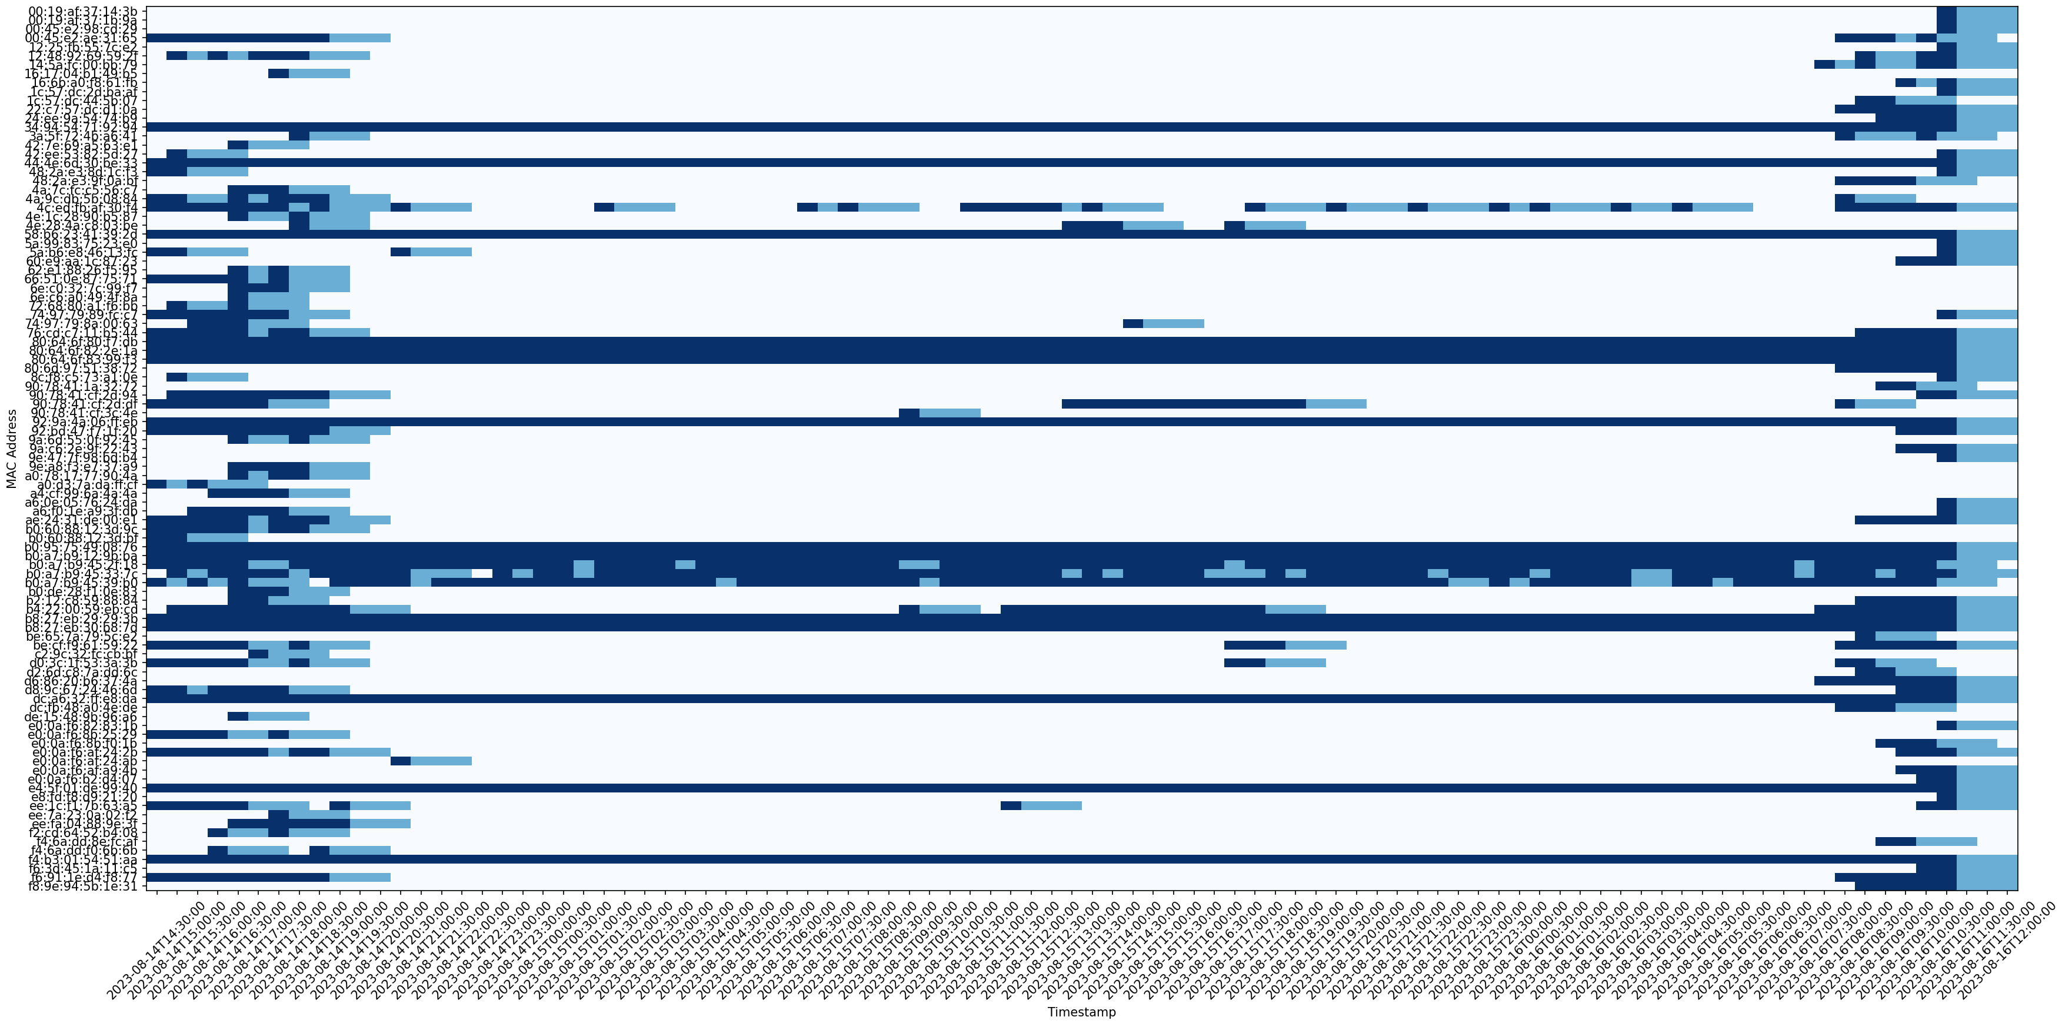
Gap filling

Slide 7
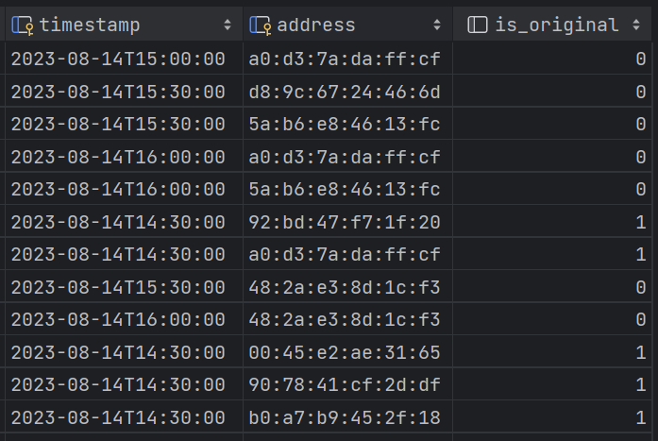
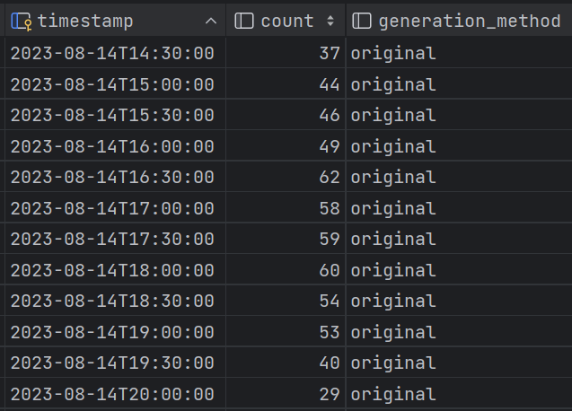
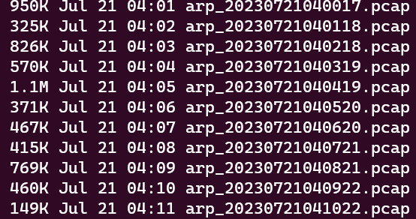
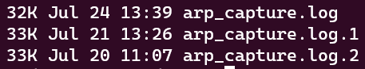
Storing Data
mac.db
count.db
The recorded network activity is stored in PCAP (Packet CAPture) files. Each file represents recorded packages for one minute. Then, they get processed and inserted to an sqlite database (mac.db), for each 30 minutes (the timestamps get rounded up), all distinct mac addresses get stored.
The script then updates another sqlite database (count.db), which contains only the number of distinct mac addresses per half hour.
Each database stores which entries are original (data from pcap files) and which data is generated. Data generation happen for every mac.db entry (3 fake datapoints get attached) and if there is no data for some time period at all.
Stored pcap files etc/arp_capture/pcap_files
Stored log files etc/arp_capture/logs

Slide 8
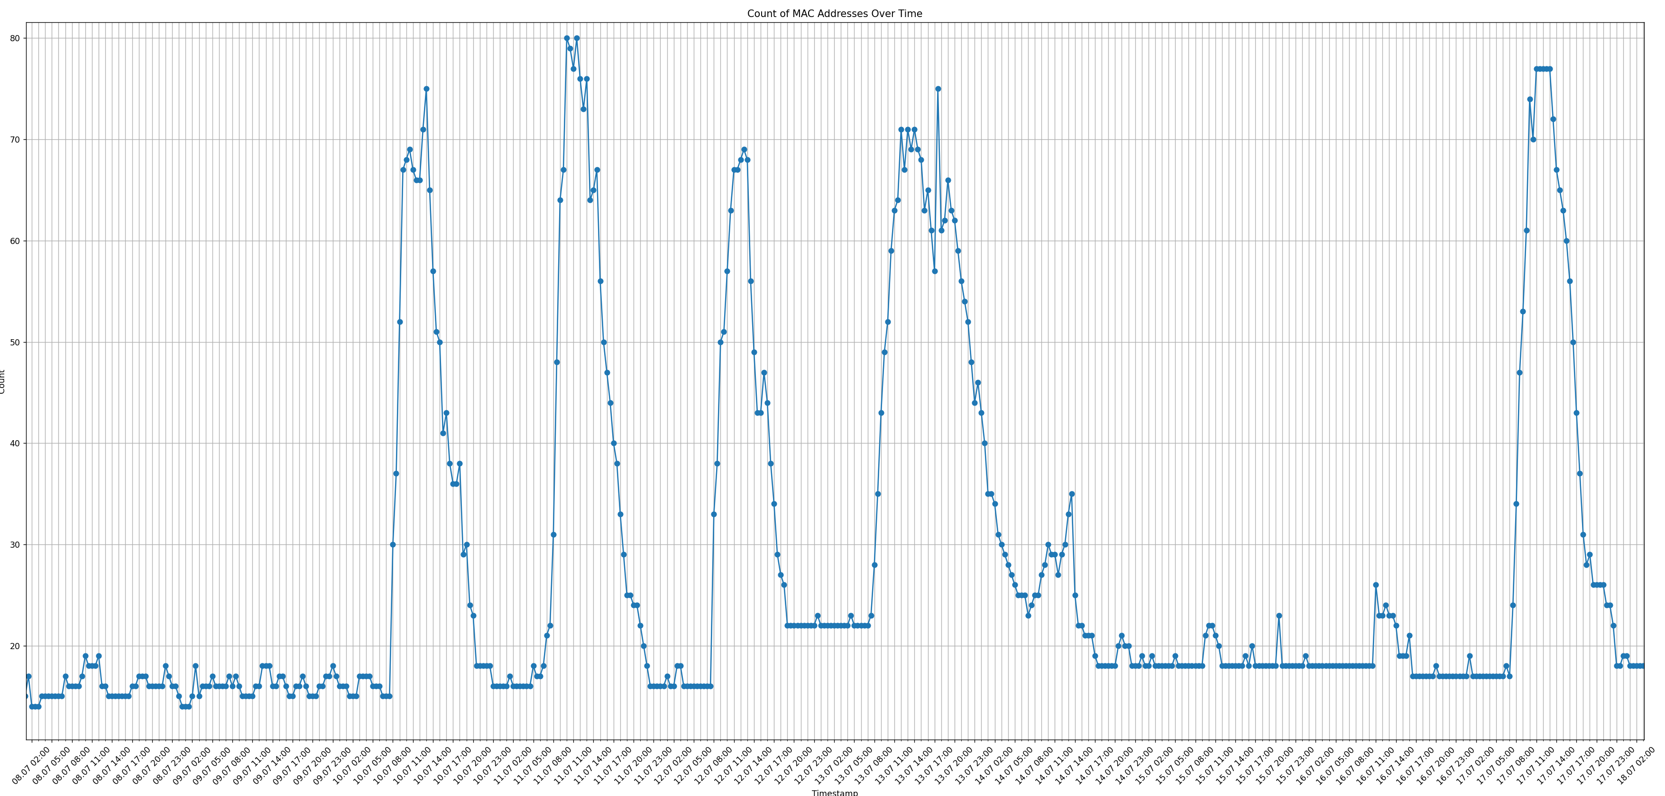
Final Data, visualized

Slide 9
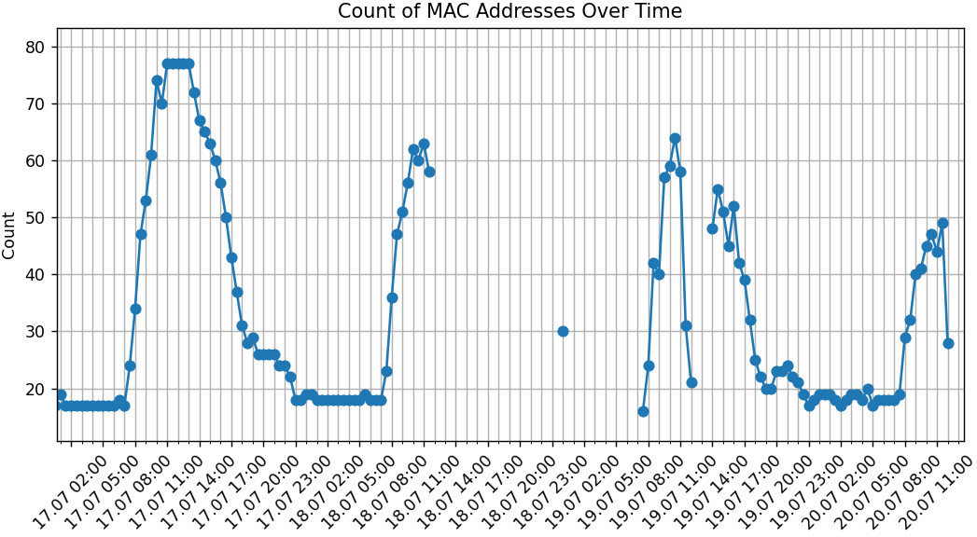
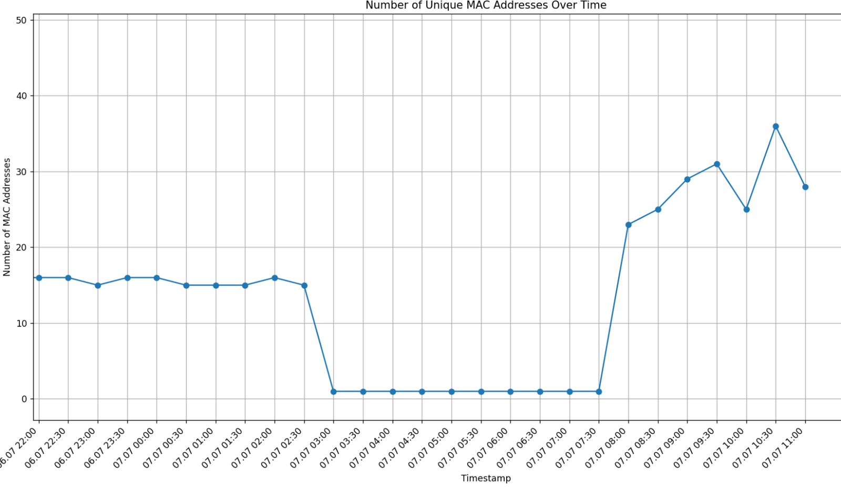
Data inconsistency
If, for any reason, no network packages are recorded, then gaps are created. If there are network issues, the SolMate only hears himself as shown in the bottom diagram.
Data loss could have many reasons, for example:
SolMate is shut down
Storage space full
Systemd Service stopped
Unexpected program error
There are a few possible solutions to this problem, which are explained on the next slide. →

Slide 10
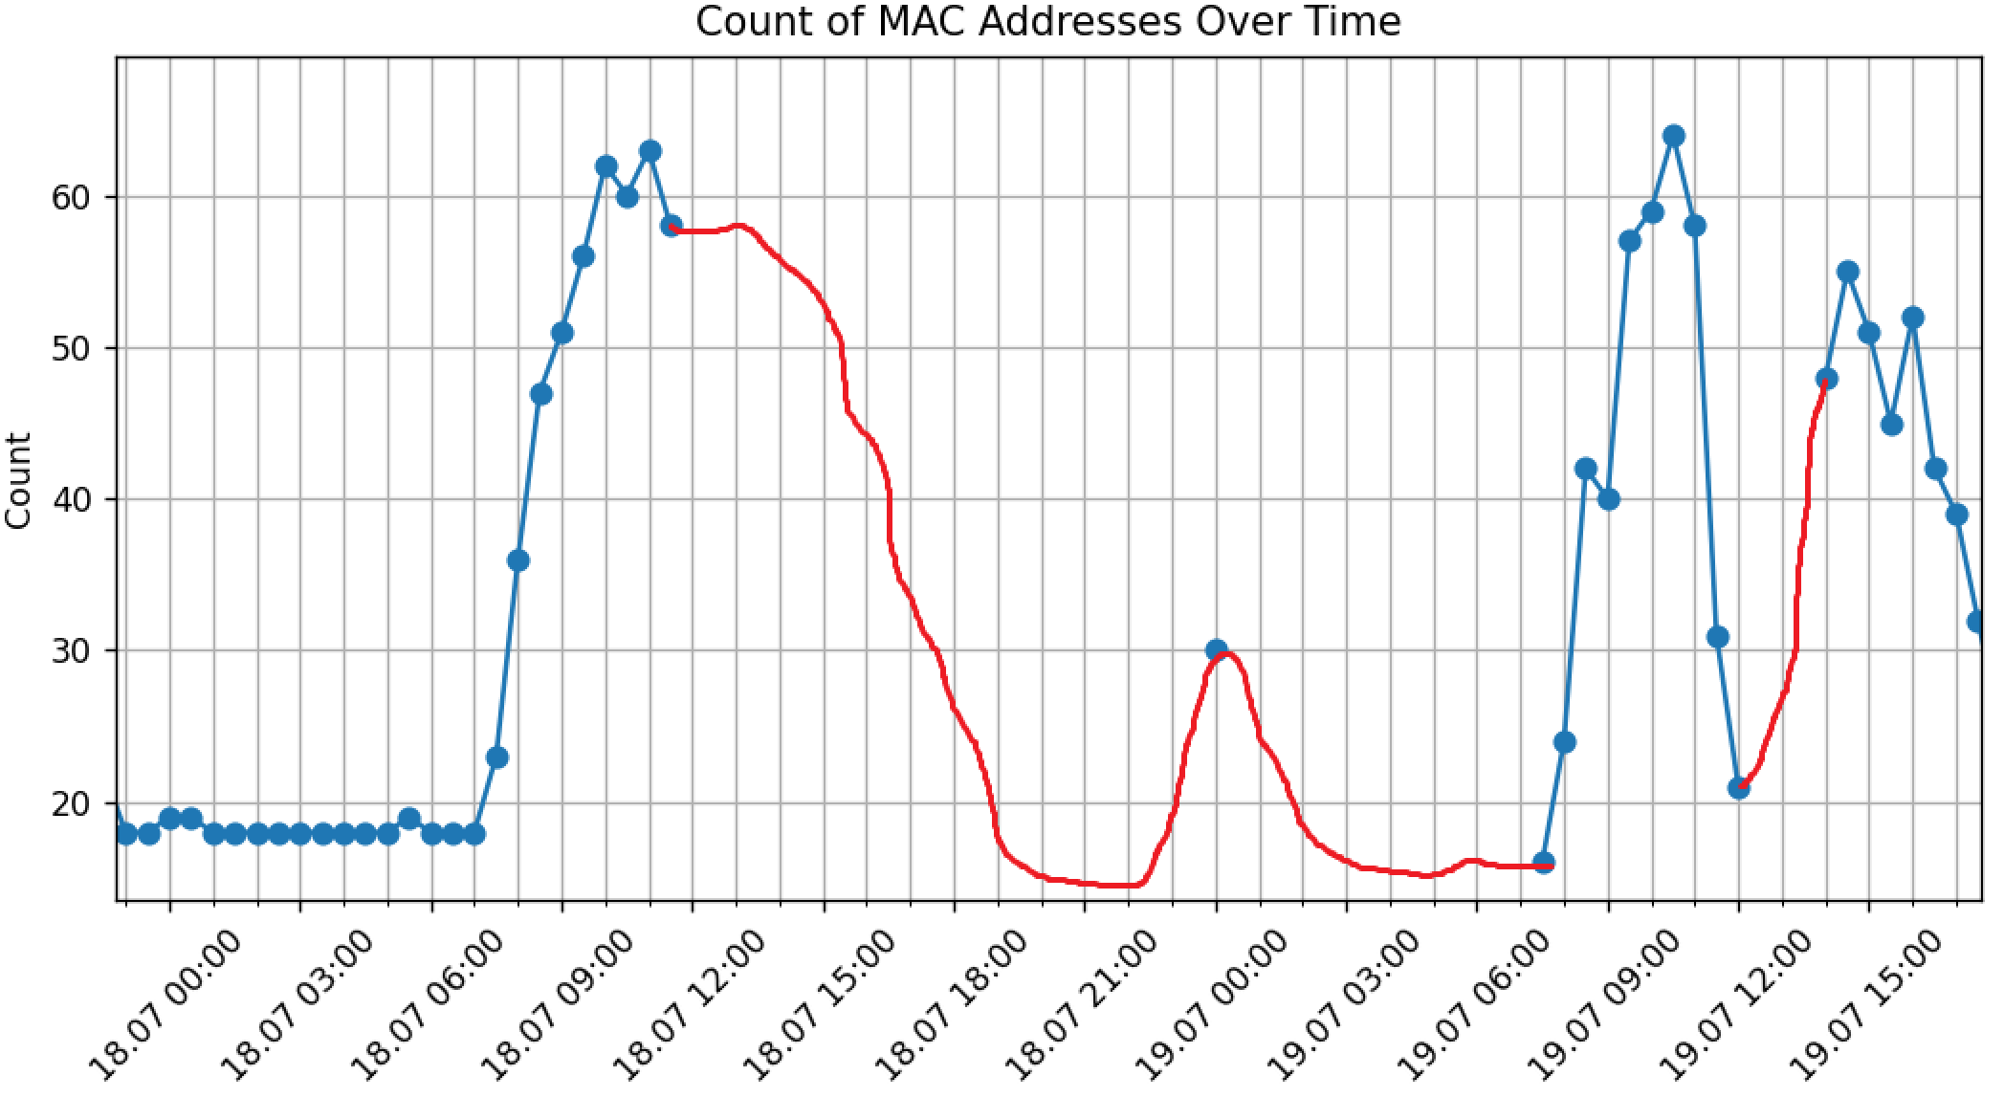
Solving data gaps
Try to fill the gap with the data from one week ago.
If there is no data from one week ago, try to fill the gap with the data from one day ago.
If none of the above steps are successful, fill the gap with 0

Slide 11
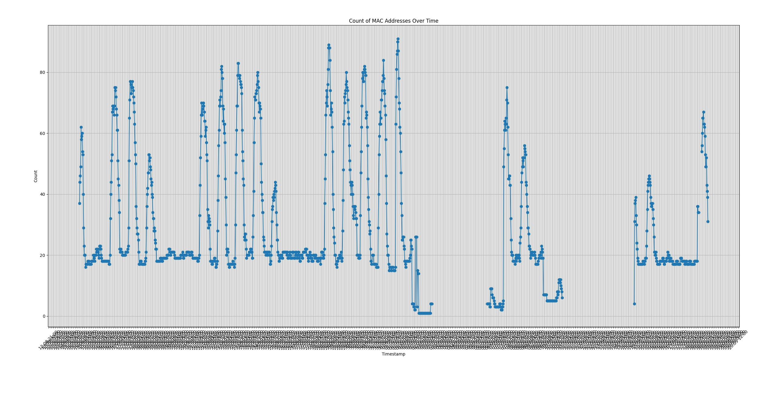

Slide 12
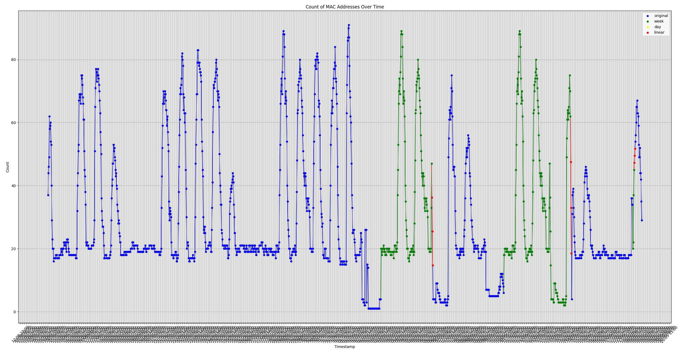

Slide 13
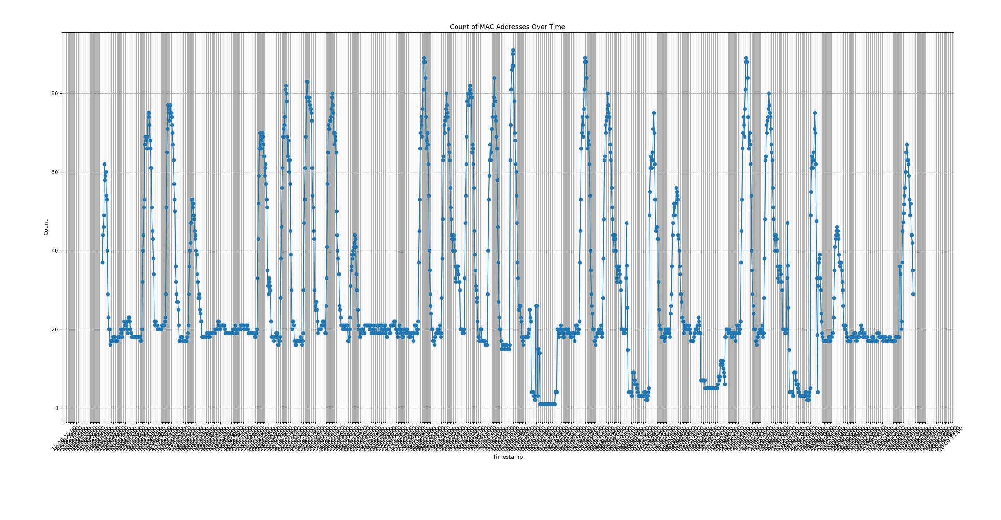

Slide 14
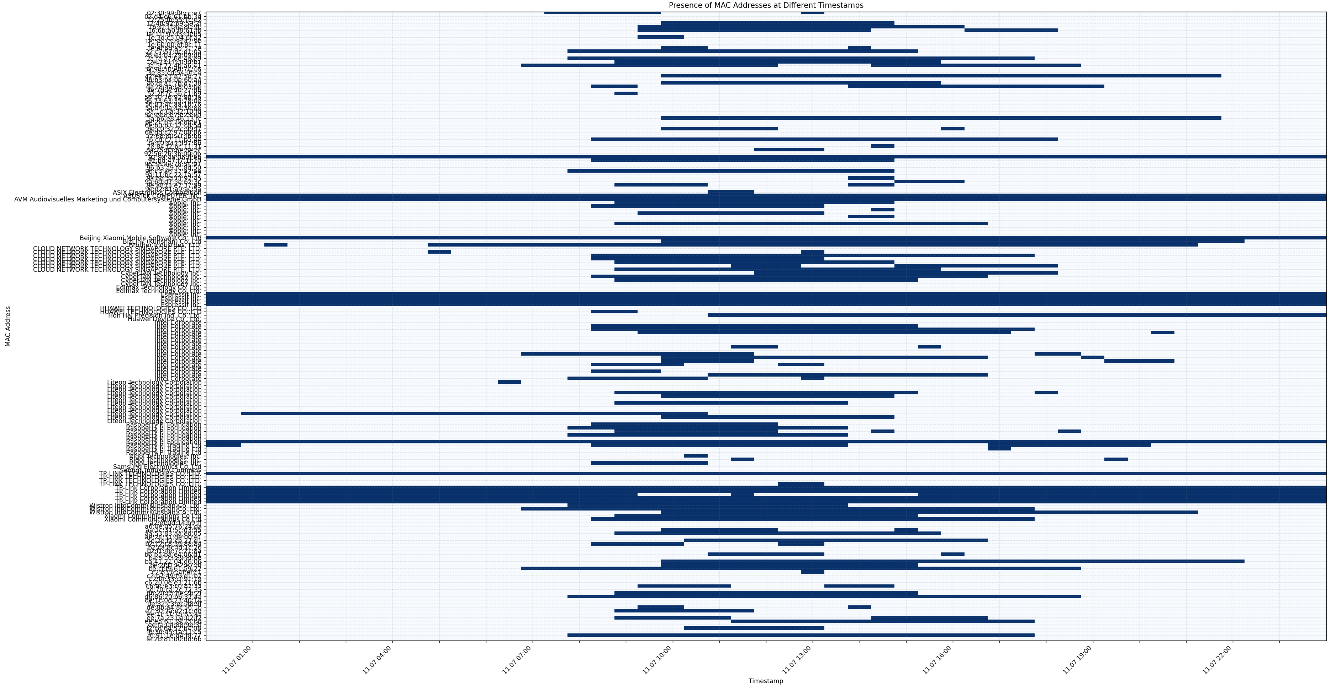
Gap-Filled Diagram (30min intervals, 1 day)

Slide 15
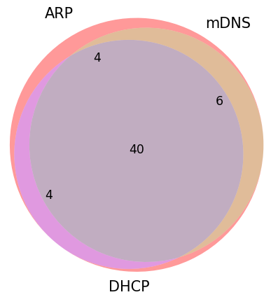
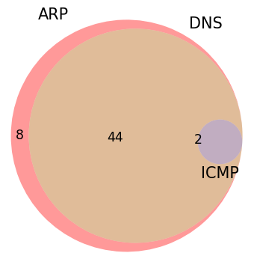
Network protocols used (Distinct MACs detected)

Slide 16
